Slide 1
Maximizing Your Inve$tment in Trade $how$
Wednesday, May 2nd, 12:00pm - 1:00pm
Presented by:
Great Lakes Women’s Business Council
Corporate Development Committee

Slide 2
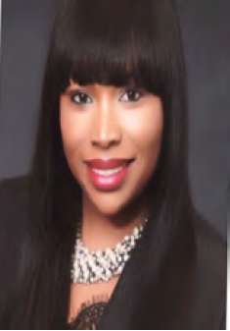
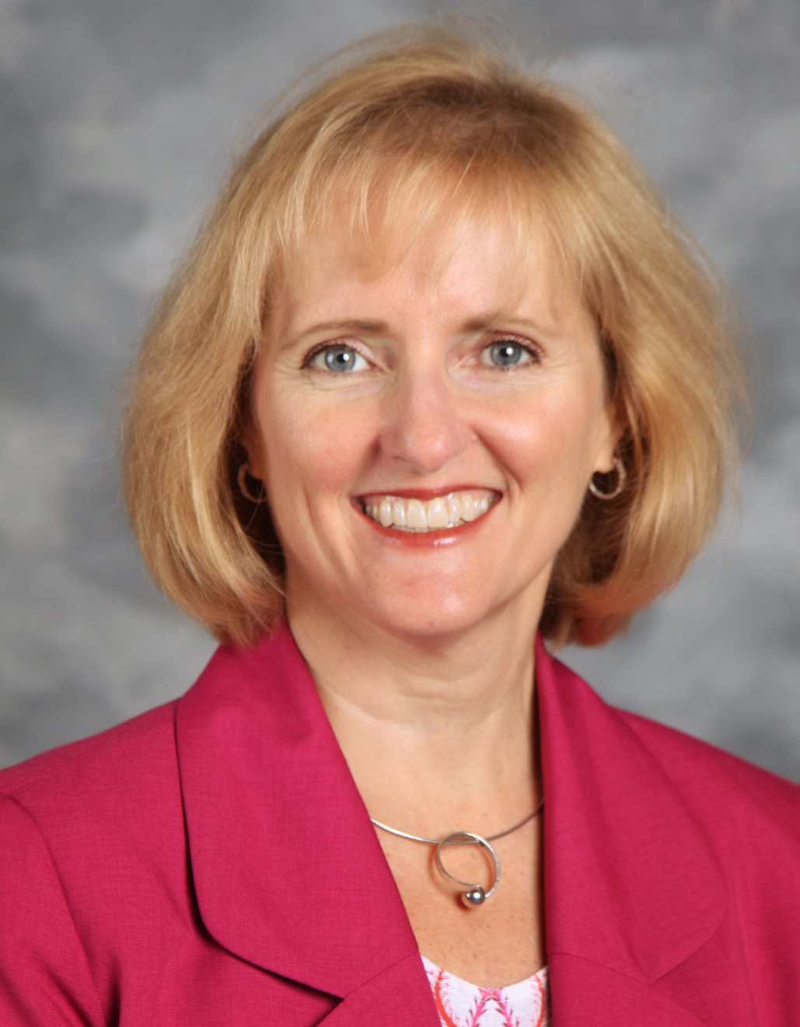
Marcia Hunter
Teresa LeFevre

Slide 3
Agenda
Set Goals – What do you want to Achieve?
Know Your Audience
Know Yourself
Time Management
Trade show Etiquette
Measuring Performance

Slide 4
Set Goals: What Return On Investment do you want from your Trade Show Dollars?
What’s in it for you?
Identify new Diversity Suppliers? Maybe not in the first conversation…
Broaden your Network? Definitely!
Re-Connect with previous Suppliers? Potential to re-establish a relationship.
Touch Base with Current Suppliers? Good practice.
Strengthen your company’s Brand/Image? Yes!
Professional Development Opportunities? Absolutely!

Slide 5
Set Goals: What Return On Investment do you want from your Trade Show Dollars?
The goals you set should dictate how you participate in the trade show.
Booth or No Booth
Level of Buyer Participation
C-Suite engagement
Sponsorship/Advertising

Slide 6
Set Goals: What ROI are you looking for?
Take a minute and set your personal goals.
What would success look/feel like?

Slide 7
Know your Audience
Pre-Work:
Survey your buyers/commodity managers to identify sourcing needs and timing
Develop list of “High Pot” Target areas and secure buyer attendance
Strategize C-Suite Engagement – if they are attending, know why and have a plan for them

Slide 8
Know your Audience
Pre-Work (continued):
Review List of Sponsors and Participants
Identify Current Suppliers (or Customers) for fly-by’s
Identify Previous Suppliers – know the story
Review Listing by Commodity to identify potential M/W/VBE suppliers
Establish a plan to collect information from buyers during or post-conference to ensure no contacts are lost
Let’s try it out…

Slide 9
Practice
List your top 3 “must meets”
List your top 3 contacts that you want to say hello to
Any past suppliers you want to check in with?
What new M/W/VBE products/services do you need to find?
“Raise your hand” or type in so we can chat with you.

Slide 10
Know Yourself
Introduction
60 seconds – who you are, what your company does, what your role is within the company
Be prepared with referral contact information (if possible) or be ready to take a follow up assignment
Practice
Take 2 minutes to prepare your intro
Let’s hear a few – volunteers?

Slide 11
Make a GREAT Impression
Confident and Knowledgeable Representatives
This is not the best time to utilize new staff
Need to have experienced folks capable of being the “Face” of your company
Understand your own org charts
This goes beyond the trade fair floor – conference wide, all events.

Slide 12
Time Management
Get the registration packet as soon as you can and use the time to go through the program book (usually available 1 or 2 days prior)
Highlight Targets and identify booth locations on floor plan, map out your route
Divide and Conquer (if possible) – assign team members to specific targets or specific regions of trade show floor

Slide 13
Trade Show Etiquette
Do: | Don’t:
Share appropriate contact information | Block communication
Provide honest feedback | Make promises you have no intention of keeping
Respect the person’s time and business – LISTEN | Avoid conversation
Know what your company needs and what it doesn’t | Tell everyone they have an opportunity

Slide 14
Measuring Performance
Old School Option:
Company Name | Contact Person | email | Product/service | Action item
ABC Janitorial | Sue Smith | ssmith@ABCJ.com | Janitorial services | Referred to facilities maintenance buyer
New Tech Tools
Card scanners or photos of business cards
On-the-spot email
“There’s an app for that”

Slide 15
Final Thoughts
Pre-Meeting with Team
Bring a checklist
items needed for your display (business cards, brochures, pens, tape, scissors, band-aids, safety pins, etc.)
list of people you want to meet
contact information within your own company that people might ask for
Pack your Patience and a Smile – Remember you are an ambassador for your company

Slide 16
Questions?

